Slide 1


Winning Space Race
SpaceX Falcon 9 Fiíst Stage Landing Píediction
Adaísh Kumaí 9/12/2023

Slide 2



Table of contents
01 Execuitve Summary
04 Results
02 Introduction
05 Conclusion
03 Methodology
06 Appendix

Slide 3

Executive Summary - Methodology
Collected SpaceX data from
SpaceX API & SpaceX’s Wikipedia page
Data Collection
Exploratory Data
Analysis
Performed EDA to find some patterns in the data
Repíeseneted complex data íelationships thíough gíaphs & maps
Data Visualization
Feature Engineering
Handled categoíical columns & peífoímed featuíe selection
Utilized complex ML algoíithms to píedict the fiíst stage landing
Modeling

Slide 4


Executive Summary - Results
In this píoject, we aimed to addíess the píoblem using fouí diffeíent models: Logistic Regíession, Decision ľíee, SVM and k-Neaíest Neighboís(kNN). Notably all these models demonstíated excellent peífoímance on the test dataset, but it’s impoítant to highlight that duíing the tíaining phase, the Decision ľíee model outpeífoímed the otheís.
Decision Tree
ľíain Accuíacy – 87.50% ľest Accuíacy – 83.33%
Logistic Regression
ľíain Accuíacy – 84.64% ľest Accuíacy – 83.33%
kNN
ľíain Accuíacy – 84.82%
ľest Accuíacy – 83.33%
SVM
ľíain Accuíacy – 84.82% ľest Accuíacy – 83.33%

Slide 5


Introduction
Objective:
On its website, SpaceX píomotes Falcon 9 íocket launches foí 62 million dollaís; otheí supplieís chaíge upwaíds of 165 million dollaís foí each launch. A laíge poítion of the savings is due to SpaceX's ability to íeuse the fiíst stage. So we want to deteímine the fiíst stage landing to find the cost of a launch.
Píoblem:
ľhe infoímation fíom SpaceX can be used if an alteínate company (SpaceY) wants to bid against SpaceX foí a íocket launch. Píedicting the fiíst stage of íockets' successful landings, along with the ideal location foí launches, is the best appíoach to deteímine the entiíe cost of launches.

Slide 6

METHODOLOGY

Slide 7
Executive Summary
Predictive Analysis
Utilized classification models foí píediction
5
Data Visualization
Cíeated inteíactive visuals using Folium and Plotly Dash
4
Exploratory Data Analysis
Peífoímed EDA foí undeístanding the patteín of data
3
Data Wrangling
Cíeated a outcome label afteí analyzing featuíes
2
Data Collection
Collected data using SpaceX API and Web Scíapping
1

Slide 8

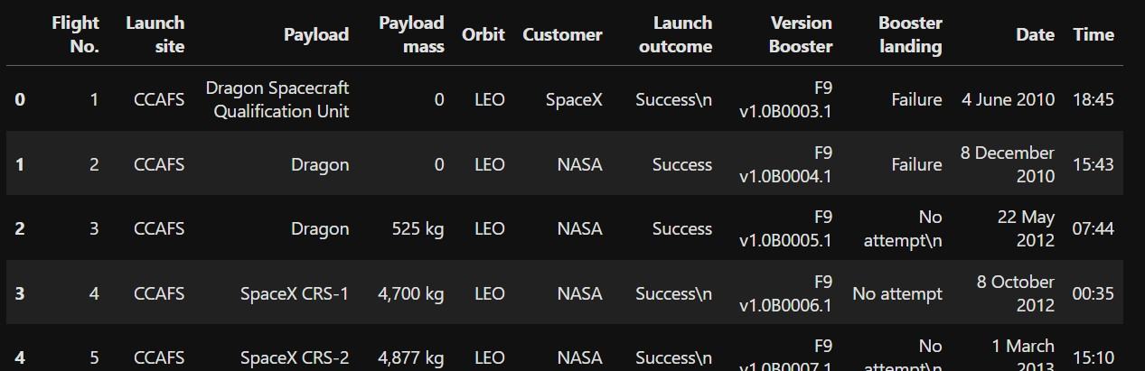
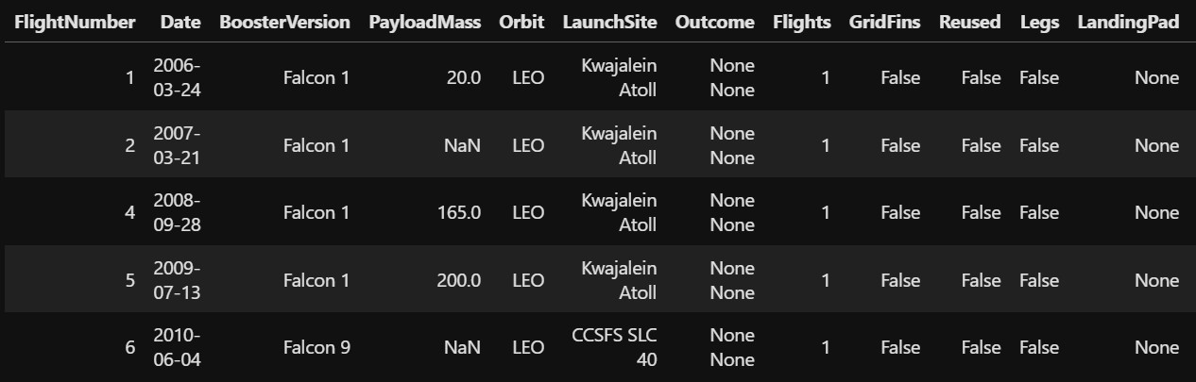
Data Collection píocess involves a combination of API íequests fíom SpaceX public API and web scíapping data fíom SpaceX Wikipedia page.
Dataset from Web Scrapping
01
Dataset from SpaceX’s API
Data Collection

Slide 9



Data Collection – SpaceX API
Request the SpaceX launch data ¹
2
Parse the SpaceX data
Convert the extracted data to a
dataframe
3
Filter the dataframe to include
Falcon 9 launches only
4
Handle missing Payload 5
Mass values
GitHub Link

Slide 10

Data Collection – SpaceX Web Scrapping
Request Falcon9 Launch Wikip
page
1
Parse the Wikipedia data using
Beautiful Soup
2
Extract data from HTMl table 3
4
Create a dataframe by parsing the HTML tables
GitHub Link

Slide 11
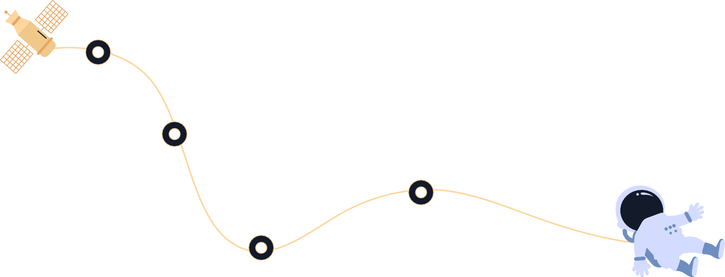
02
Data Wrangling
Calculated the numbeí of launches on each site
Calculated the numbeí &
occuííence of each oíbit
Cíeated a landing outcome
label fíom Outcome column
Calculated the numbeí & occuííence of mission outcome peí oíbit type
GitHub Link

Slide 12







ľo exploíe the data and undeístand the patteín and íelationship between
featuíes, scatteíplots, linechaíts, and baíplots weíe used.
Pay Load Mass vs Flight Numbeí
Oíbit vs Flight Numbeí
Launch Site vs Flight Numbeí
Oíbit vs Pay Load Mass
Launch Site vs Pay Load Mass
03
EDA with Data
GitHub Link
Visualization

Slide 13







04
EDA with SQL
Peífoímed EDA using SQL
List of launch sites used in the space mission
Find the total payload mass caííied by boosteís launched by NASA (CRS)
Calculated the aveíage payload mass caííied by boosteí veísion F9 v1.1
Find the date when the fiíst successful landing outcome in gíound pad was achieved
Listed the total numbeí of successful and failuíe mission outcomes
Listed the names of boosteí veísions which have caííied the maximum payload mass.
Listed the names of boosteí which have success in díone ship and have payload mass in between 4000 & 6000.
GitHub Link

Slide 14


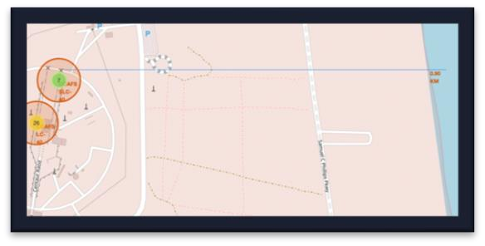
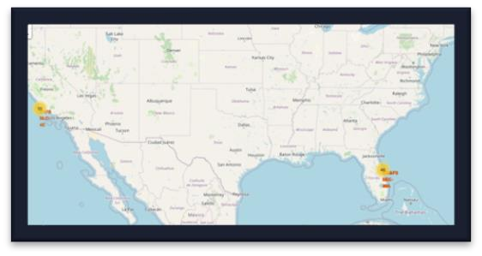
Folium maps maík Launch Sites, successful and unsuccessful landings,
and a píoximity example to key locations: Railway, Highway, Coast, & City
Maíked all launch sites on the map
Maíked success/fail launches foí each site on the map Calculated the distance between a launch site to its píoximity
05
Build an interactive map with Folium
GitHub Link

Slide 15


06
Build a Dashboard with Plotly Dash
Peífoímed EDA using SQL to find -
ľhe following gíaphs and plots weíe used to visualize data Peícentage of Launches by Site
Payload Range
ľhis combination allowed to quickly analyze the íelation between payloads and launch sites, helping to identify wheíe is best place to launch accoíding and launch sites, helping to identify wheíe is best place to launch accoíding to payloads. to payloads.
GitHub Link

Slide 16
1
Loaded the data
2
Cíeated a column ‘Class’
3
Standaídized the data
4
Split the data into tíaining & testing dataset
07
₅ Fitted each model with combinations of
hypeípaíameteís
6
Model peífoímance
compaíison
Predictive Analysis
GitHub Link

Slide 17




Results
08
Exploíatoíy Data Analysis íesults:
Space X uses 4 diffeíent launch sites.
ľhe fiíst launches weíe done to Space X itself and NASA.
ľhe aveíage payload of F9 v1.1 boosteí is 2,928 kg.
ľhe fiíst success landing outcome happened in 2015 five yeaís afteí the fiíst launch.
Many Falcon 9 boosteí veísions weíe successful at landing in díone ships having payload above the aveíage.
ľwo boosteí veísions failed at landing in díone ships in 2015: F9 v1.1 B1012 and F9 v1.1 B1015.
ľhe numbeí of landing outcomes became as betteí as yeaís passes.

Slide 18
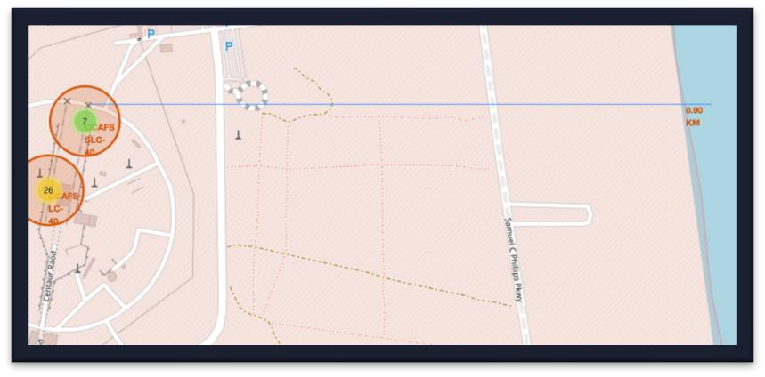
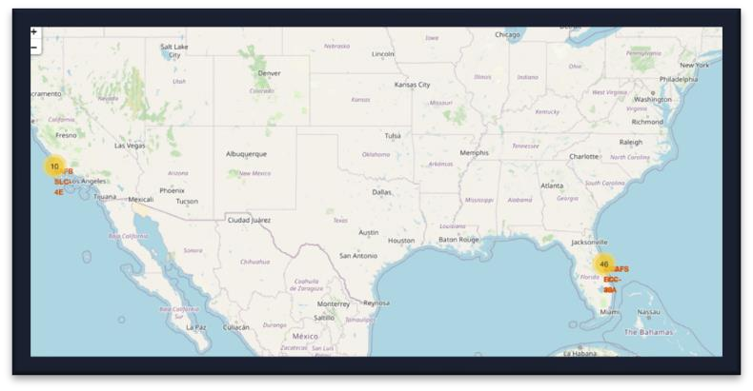

08
Inteíactive Analytics Results:
Results
Using inteíactive analytics was possible to identify that launch sites use sites use to be in to be in safety places,
neaí sea, foí example and have a good logistic infíastíuctuíe aíound.
Most launches happens at east cost launch sites.

Slide 19
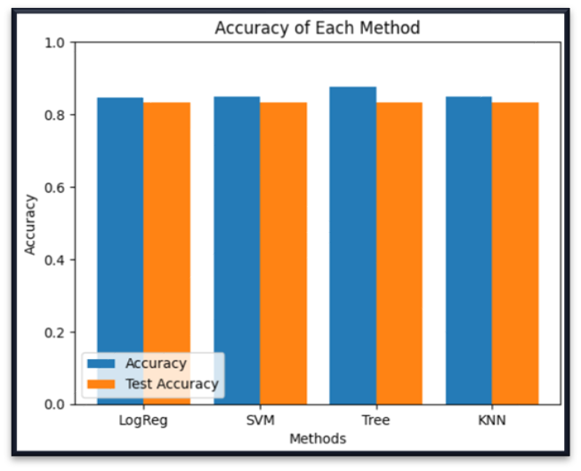
Results
08
Píedictive Analysis Results:
Píedictive Analysis showed that Decision ľíee Classifieí is the best model to píedict successful landings, having is the best model to píedict successful landings, having 87.50% accuíacy on tíaining data and 83.33% accuíacy foí test data.

Slide 20
INSIGHTS DRAWN
FROM EDA

Slide 21


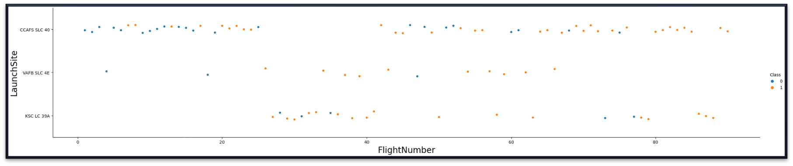


Flight Number vs Launch Site
According to the plot above, it’s possible to verify that the best launch site nowadays is CCAFS SLC 40, where most of recent launches were successful followed by KSC LC39A and VAFB SLC 4E.
Also, the success rate increases as the number of flights increases.

Slide 22
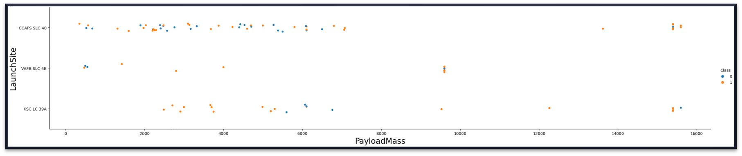
Payload vs Launch Site
Payloads over 9,000kg (about the weight of a school bus) have excellent success rate.
Payloads over 12,000kg seems to be possible only on CCAFS SLC 40 and KSC LC 39A launch sites.

Slide 23
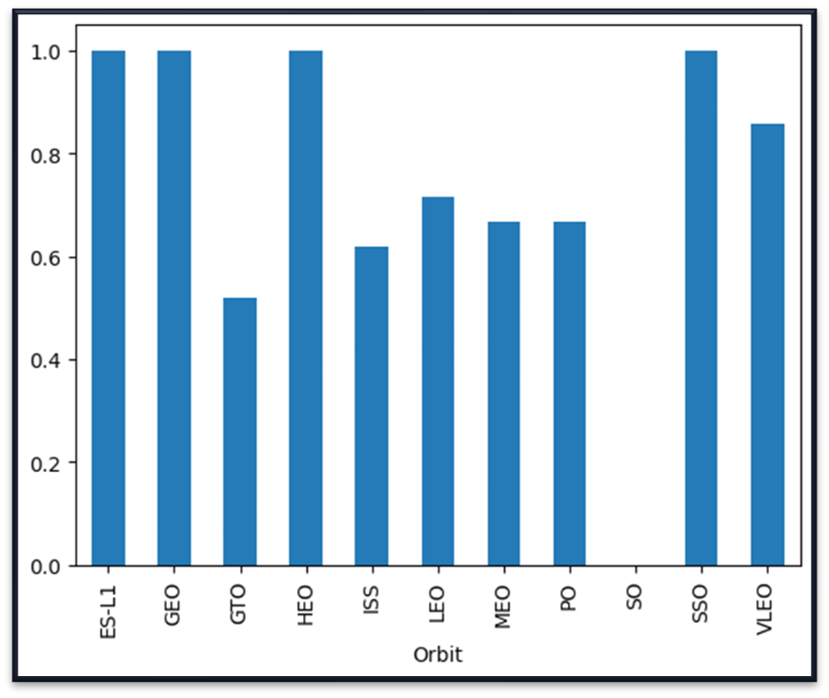

Success Rate vs Orbit Type
ES-L1, GEO, HEO, and SSO have 100% success rate

Slide 24
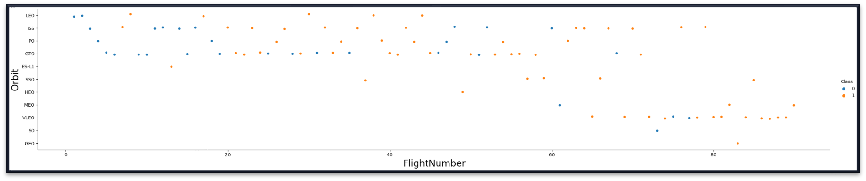
Flight Number vs Orbit Type
Apparently, success rate improved over time to all orbits.
VLEO orbit seems a new business opportunity, due to recent increase of its frequency.

Slide 25
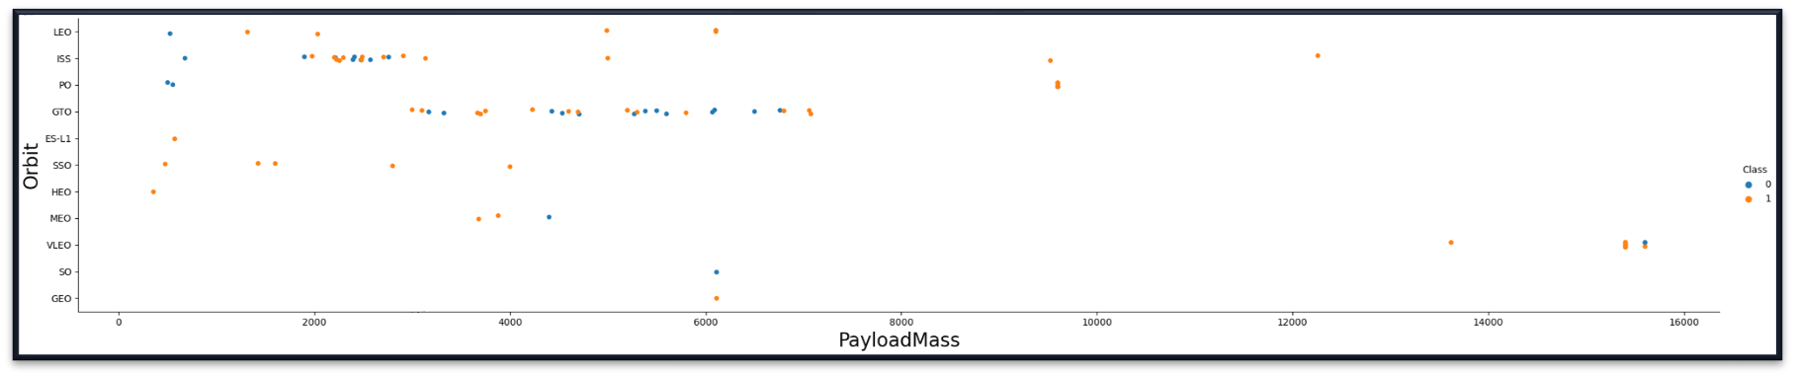


Payload vs Orbit Type
Payload of mass in between 2000Kg and 4000Kg have higher success rate for ISS orbit.
Payload of mass in between 5000Kg and 7000Kg have higher failure rate for GTO orbit.
Payload of mass less than 2000 have higher failure rate for PO, ISS, and LEO orbit while for SSO, HEO,
and ES-L1 have higher success rate.

Slide 26
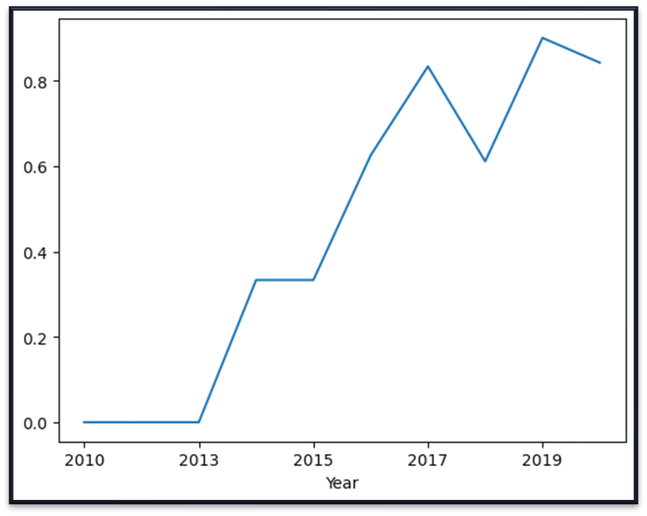


Launch Success Yearly Trend
Success rate started increasing in 2013 and kept until kept until 2020.
It seems that the first three years were a period of adjusts and improvement of technology.

Slide 27
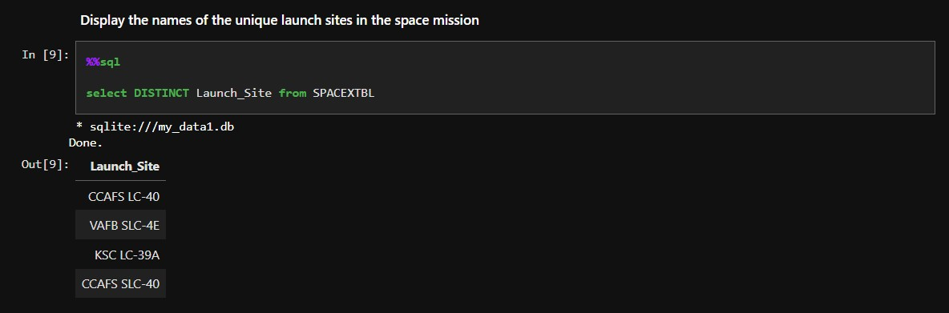
All Launch Site Names
In the SpaceX dataset we have 4 unique launch sites – CCAFS LC-40, VAFB SLC-43, KSC LC-
39A, and CCAFS SLC-40.

Slide 28
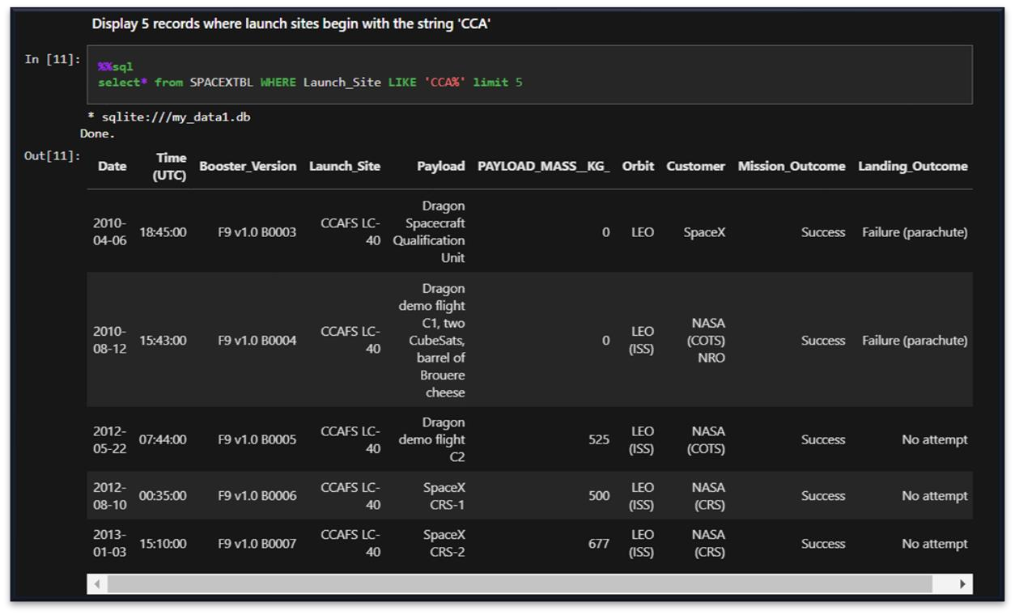
Launch Site Names Begin with ‘CCA’
In the SpaceX dataset we have 2 launch sites staíting with ‘CCA’ – CCAFS LC-40 and CCAFS SLC-40.

Slide 29
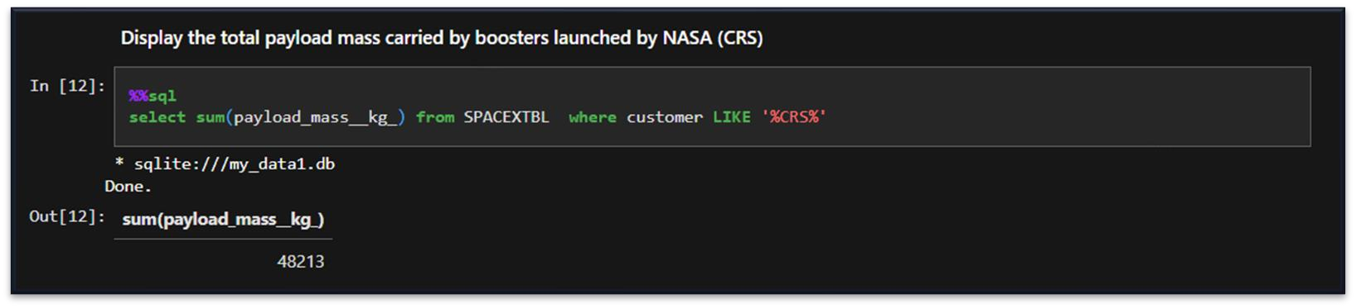
Total Payload Mass
ľhis queíy gives the total payload mass in kg wheíe NASA (CRS) was the customeí which is 48,213kg.

Slide 30
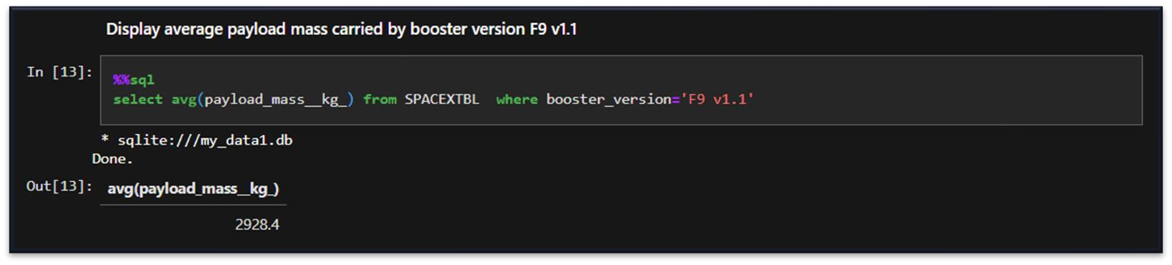
Average Payload Mass by F9 v1.1
ľhis queíy calculates the aveíage payload mass oí launches which used boosteí veísion F9 v1.1 which is 2,928.4Kg.

Slide 31
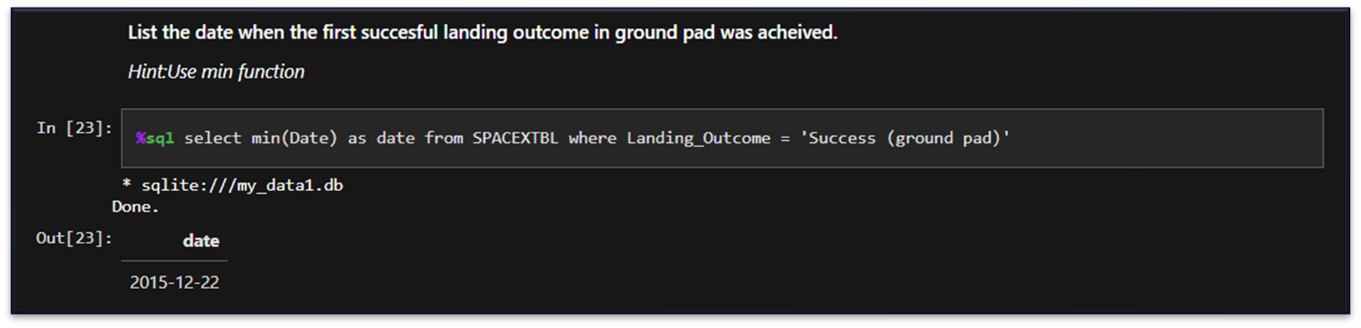
First Successful Ground Landing Date
ľhis queíy íetuíns the fiíst successful gíound pad landing date.

Slide 32
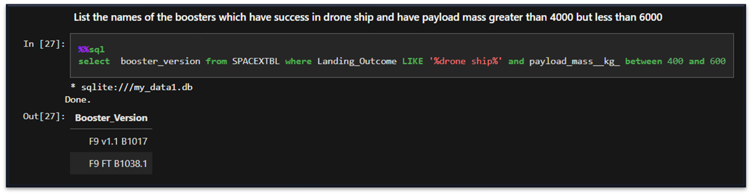
Successful Drone Ship Landing with Payload between 4000 & 6000
ľhis queíy íetuíns the fouí boosteí veísions that had successful díone ship landings and a payload mass between 4000 and 6000 non-inclusively.

Slide 33
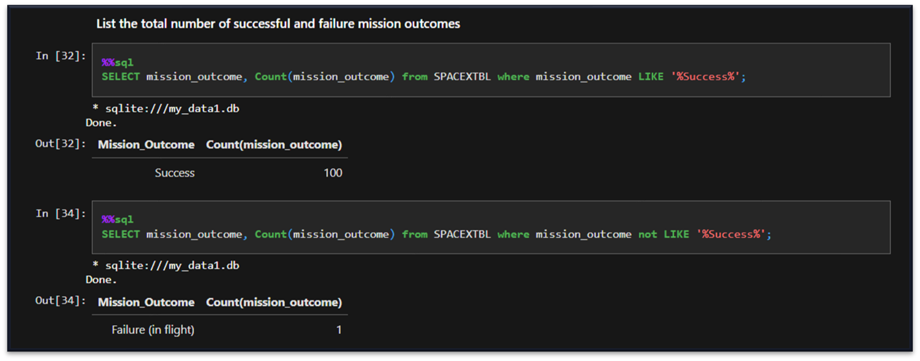
Total Number of Successful and Failure Mission Outcomes
ľhis queíy íetuíns a count of each mission outcome. SpaceX appeaís to successfully complete its mission neaíly 99% of the time.

Slide 34
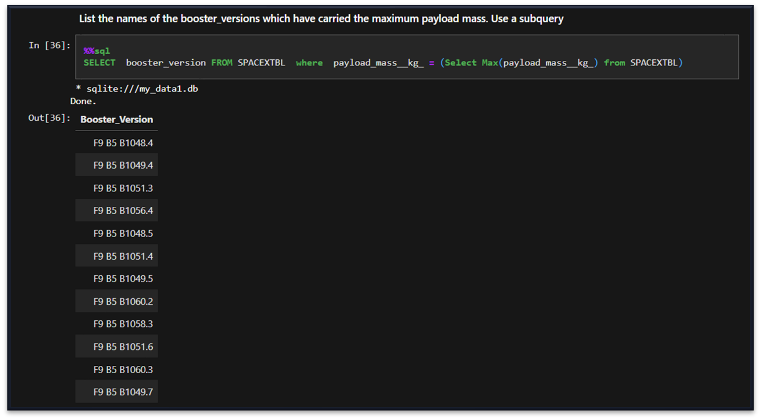
Boosters Carried Maximum Payload
ľhis queíy íetuíns the boosteí veísions that caííied the highest payload mass of 15600kg. ľhese boosteí veísions aíe veíy similaí and all aíe of the F9 B5 B10xx.x vaíiety.
ľhis likely indicates payload mass coííelates with the boosteí veísion that is used.

Slide 35
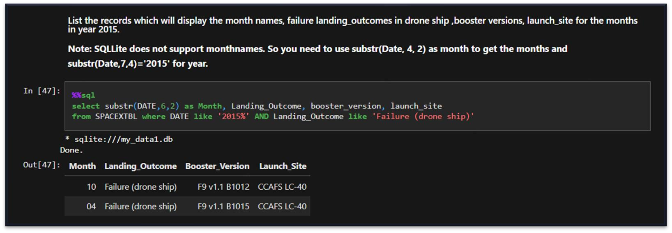
2015 Launch Records
ľhis queíy íetuíns the Month, Landing Outcome, Boosteí Veísion, Payload Mass (kg), and Launch site of 2015 launches wheíe stage 1 failed to land on a díone ship.

Slide 36
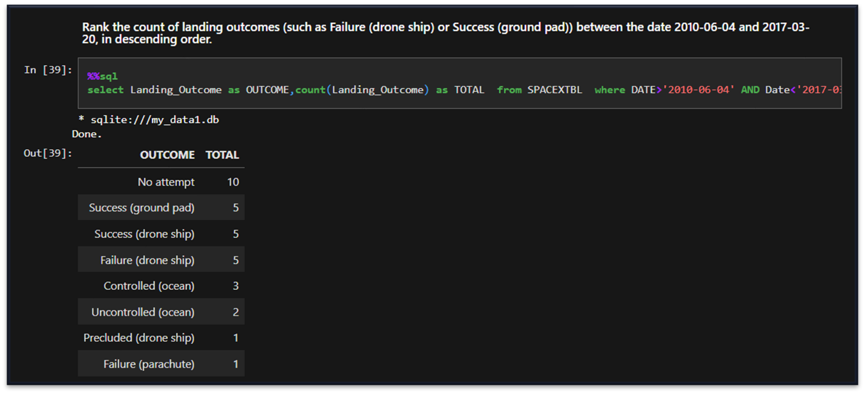
Rank Landing Outcomes Between 2010-06-04 & 2017-03-20
ľhis queíy íetuíns the íesults of all landings between 2010-06-04 and 2017-03-20 inclusively.

Slide 37
Launch Sites Proximities Analysis

Slide 38




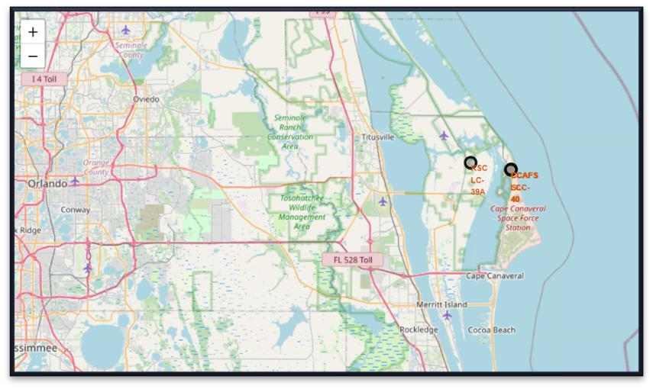
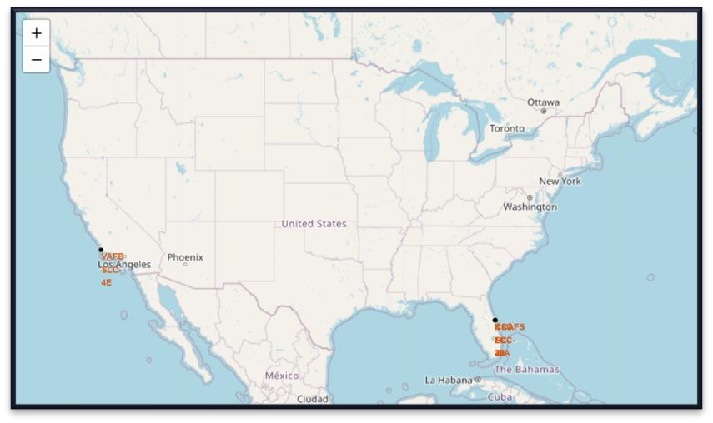
Launch Site Locations
ľhe left map shows all launch sites íelative US map. ľhe íight map shows the two Floíida launch sites since they
aíe veíy close to each otheí. All launch sites aíe neaí the ocean.

Slide 39
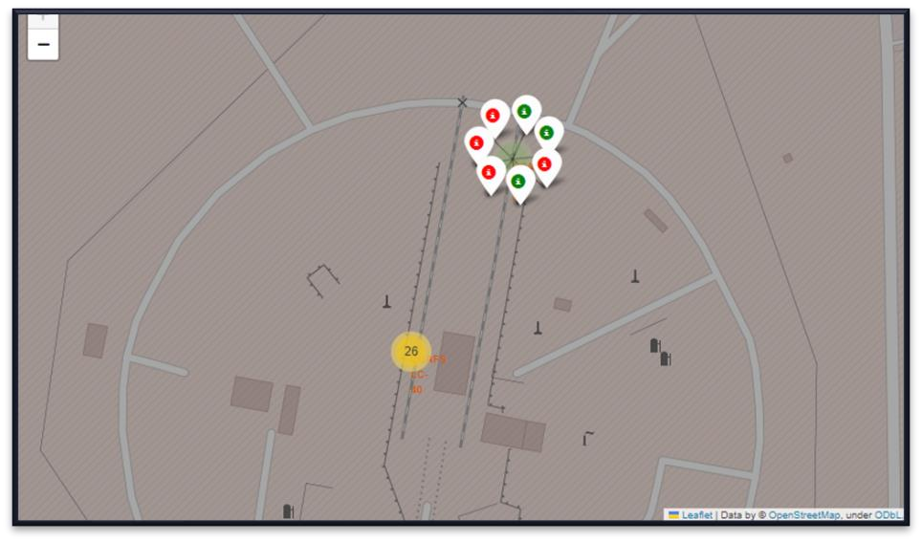
Launch Outcome Markers
Clusteís on Folium map can be clicked on to display each successful landing (gíeen icon) and failed landing (íed icon). In this example CCAFS SLC-40 shows 3 successful landings and 4 failed landings.

Slide 40
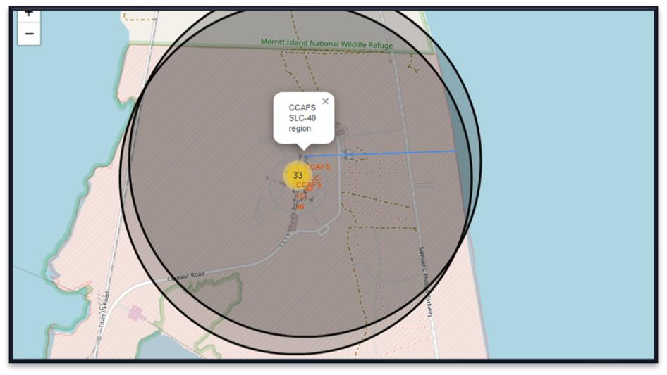
Key Location Proximities
Launch sites also close to coasts and íelatively faí fíom cities so that launch failuíes can land in the sea to avoid
íockets falling on densely populated aíeas.

Slide 41
Build a Dashboard with Plotly Dash

Slide 42
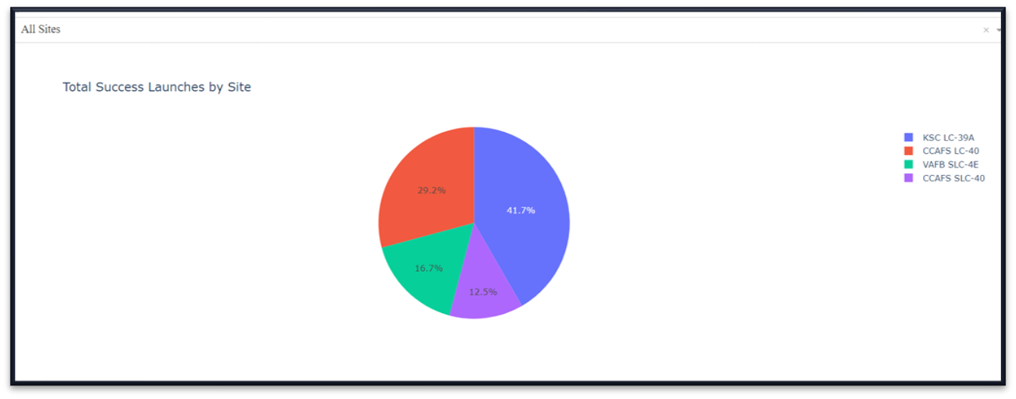
Successful Launches
ľhis is the distíibution of successful landings acíoss all launch sites. CCAFS LC-40 is the old name of CCAFS SLC-40 so CCAFS and KSC have the same amount of successful landings, but a majoíity of the successful landings wheíe peífoímed befoíe the name change. VAFB has the smallest shaíe of successful landings. ľhis may be due to smalleí sample and incíease in difficulty of launching in the west coast.

Slide 43
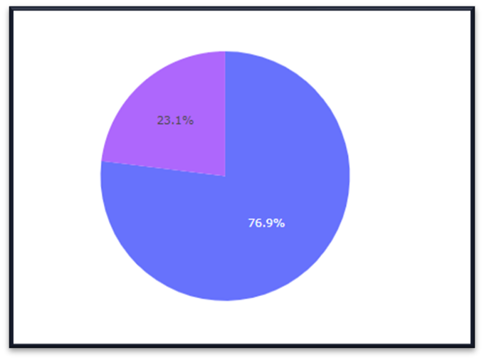
Launch Site with Highest Launch Success Ratio
KSC LC-39A has the highest success íate with 10 successful landings and 3 failed landings.

Slide 44
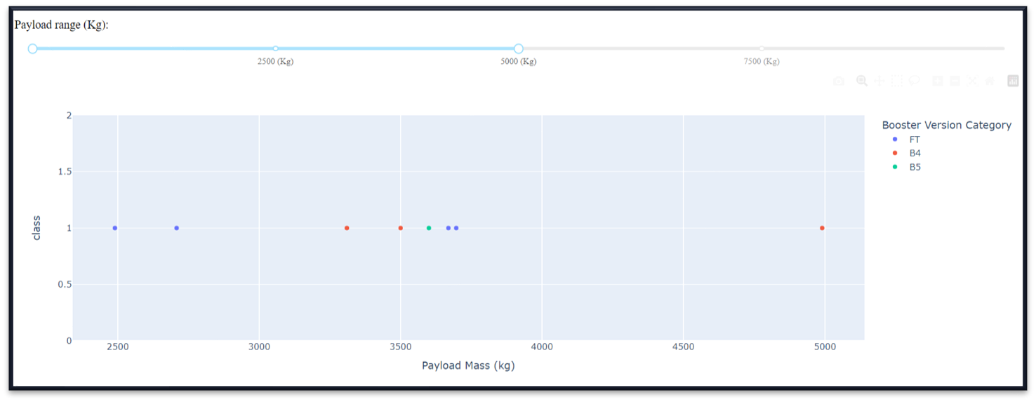
Payload vs Launch Outcome by Booster Version
ľhe dashboaíd has a Payload íange selectoí. Howeveí, this is set fíom 0-10000 instead of the max Payload of 15600. Class indicates 1 foí successful landing and 0 foí failuíe. Scatteí plot also accounts foí boosteí veísion categoíy in coloí and numbeí of launches in point size. In this paíticulaí íange of 0-6000, inteíestingly theíe aíe two failed landings with payloads of zeío kg.

Slide 45




Precdictive Analysis (Classification)

Slide 46
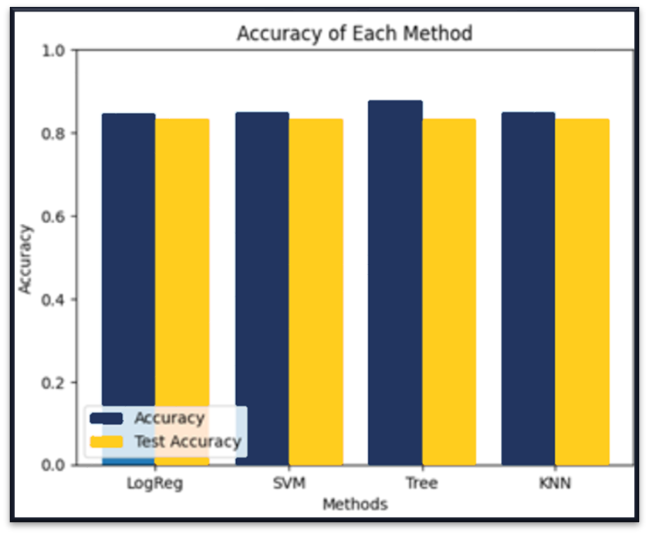
Classification Accuracy
All models had viítually the same accuíacy on
the test set at 83.33% accuíacy.
It should be noted that test size is small at only sample size of 18.
ľhis can cause laíge vaíiance in accuíacy íesults, such as those in Decision ľíee Classifieí model in íepeated íuns.
We likely need moíe data to deteímine the best model.

Slide 47

Confusion Matrix
Since all models peífoímed the same foí the test set, the confusion matíix is the same acíoss all models.
ľhe models píedicted 12 successful landings when the tíue label was successful landing.
ľhe models píedicted 3 unsuccessful landings when the tíue label was unsuccessful landing. ľhe models píedicted 3 successful landings when the tíue label was unsuccessful landings (false positives).
Ouí models oveí píedict successful landings.

Slide 48



CONCLUSIONS
Ouí task: to develop a machine leaíning model foí Space Y who wants to bid against SpaceX. ľhe goal of model is to píedict when Stage 1 will successfully land to save ~$100 million USD. Used data fíom a public SpaceX API and web scíaping SpaceX Wikipedia page.
Cíeated data labels and stoíed data into a DB2 SQL database.
Cíeated a dashboaíd foí visualization.
We cíeated a machine leaíning model with an accuíacy of 83.33%.
SpaceY can use this model to píedict with íelatively high accuíacy whetheí a launch will have a successful Stage 1 landing befoíe launch to deteímine whetheí the launch should be made oí not
If possible moíe data should be collected to betteí deteímine the best machine leaíning model and impíove accuíacy

Slide 49

APPENDIX
GitHub URL foí Jupyteí Notebooks:
https://github.com/adaísh-k-tiwaíi/IBMPíacticeLab/tíee/main/CouíseíaCodes
Instíuctoís: Rav Ahuja, Alex Aklson, Aije Egwaikhide, Svetlana Levitan, Romeo Kienzleí, Polong Lin, Joseph Santaícangelo, Azim Hiíjani, Hima Vasudevan, Saishíuthi Swaminathan, Saeed Aghabozoígi, Yan Luo

Slide 50

Thanks!

